Slide 1
Module 7 Guided Lab - Creating a VPC Peering Connection
Made for Professor Lanham A. by Amrit Singh

Slide 2
AGENDA
Accessing the AWS management console
Task 1 : Creating a VPC peering connection
Task 2 : Configuring route tables
Task 3 : Testing the VPC peering connection

Slide 3
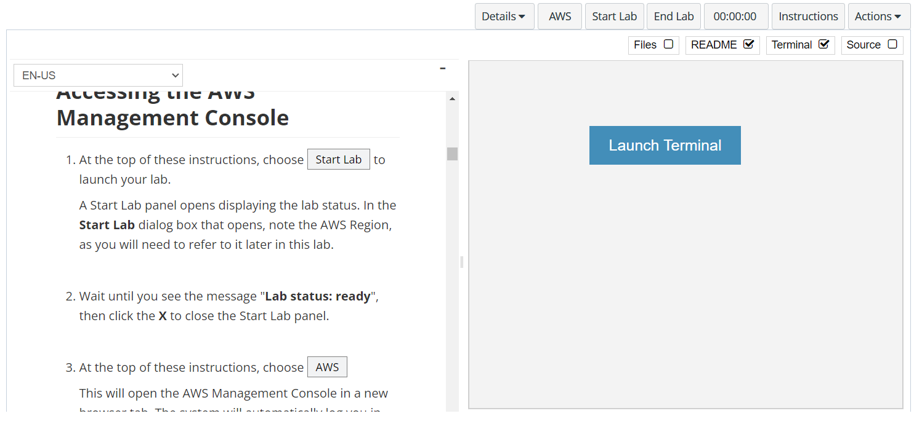
In aws labs click on start lab

Slide 4
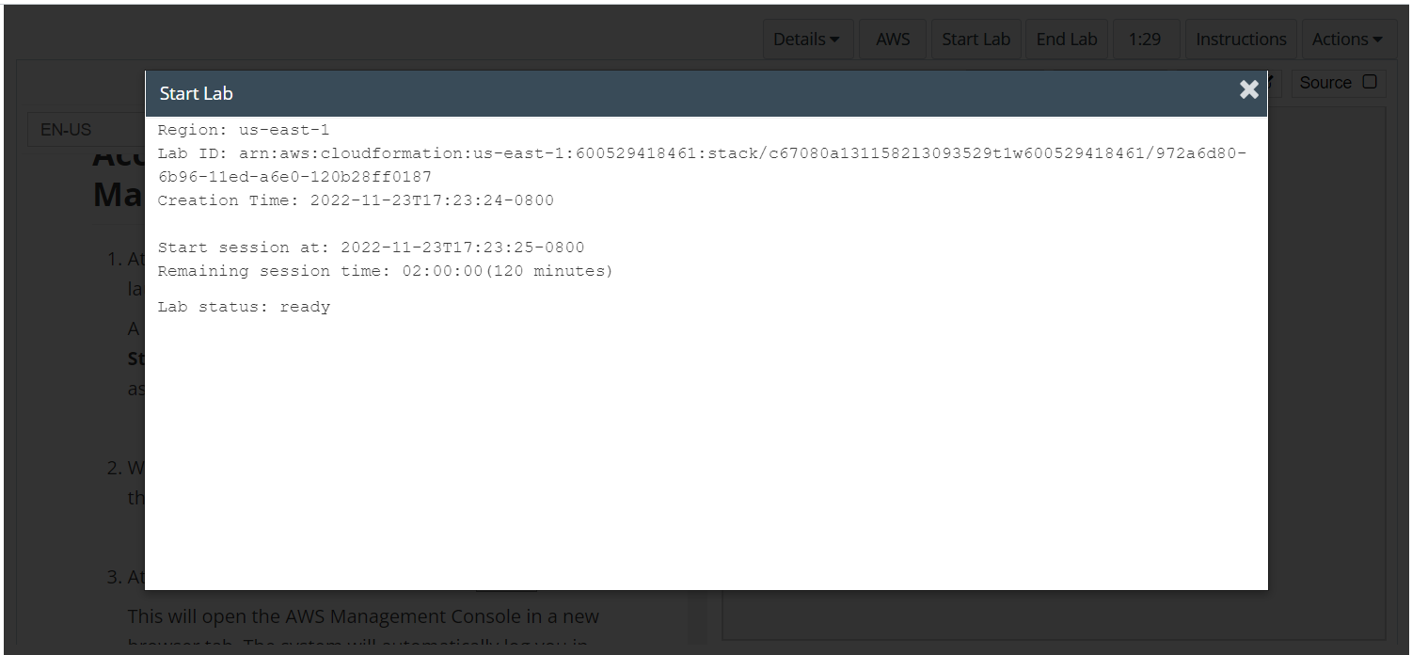
Wait to see lab ready status in the window then press x and click on aws to launch console

Slide 5
Task 1 : Creating a VPC

Slide 6
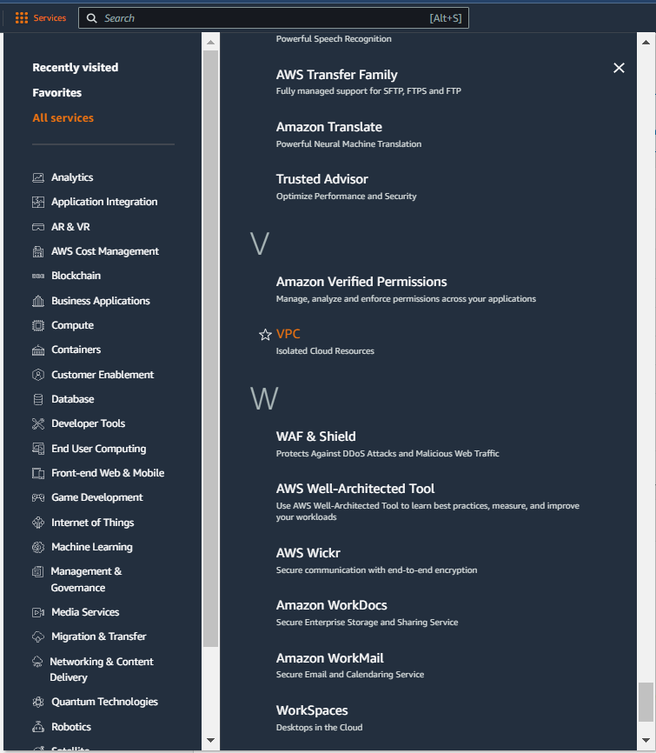
Select services and then click on VPC button
Click on the Services button
Click on the VPC button

Slide 7
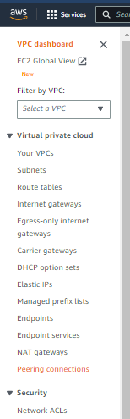
Click on YOUR peering connections button

Slide 8
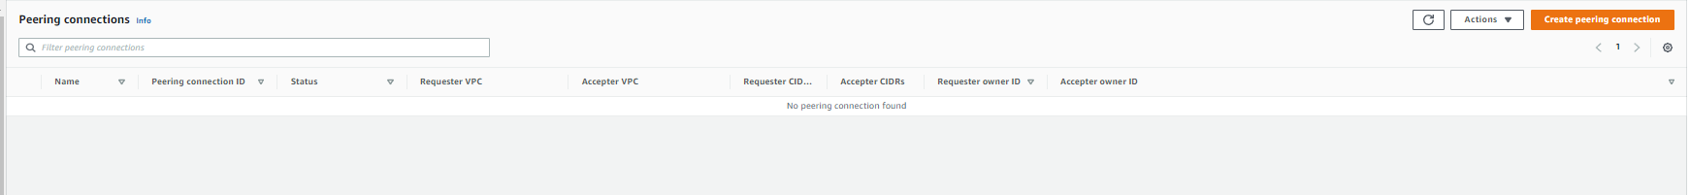
CLICK ON CREATE peering connection BUTTON

Slide 9
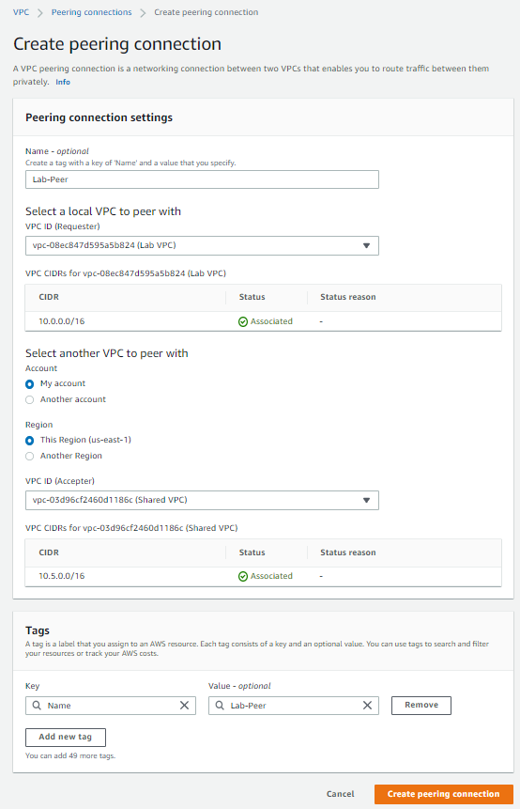
UPDATE THE VPC peering SETTINGS WITH name, Requester - lab vpc and accepter – Shared vpc as shown in the labs, click create peering connections

Slide 10
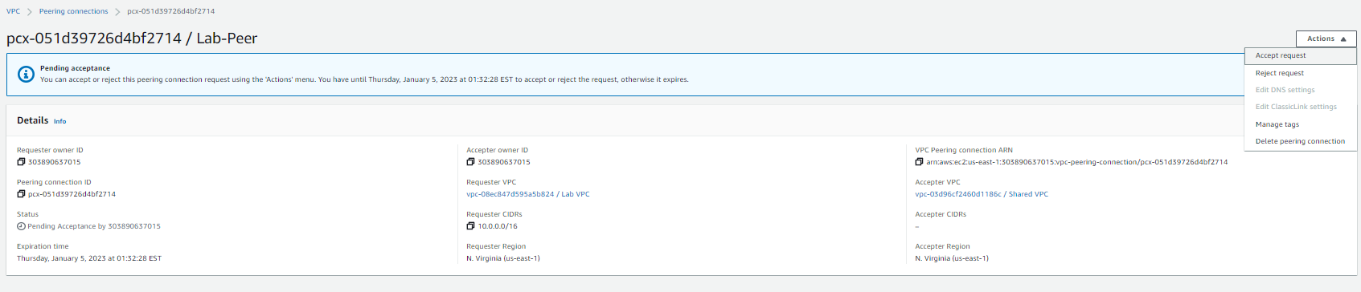
Click on actions and then accept request > accept request

Slide 11
Task 2 : Configuring route tables

Slide 12
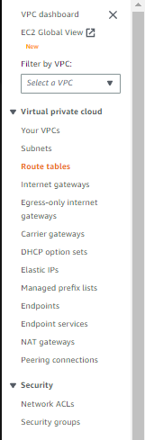
Click on route tables in the navigation pane
Click on route tables

Slide 13
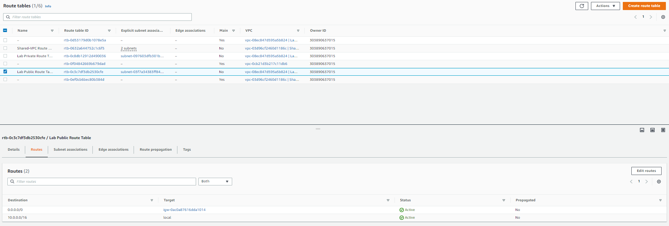
In the route tables tab, select lab public route table and switch to routes subtab, then click on edit routes

Slide 14
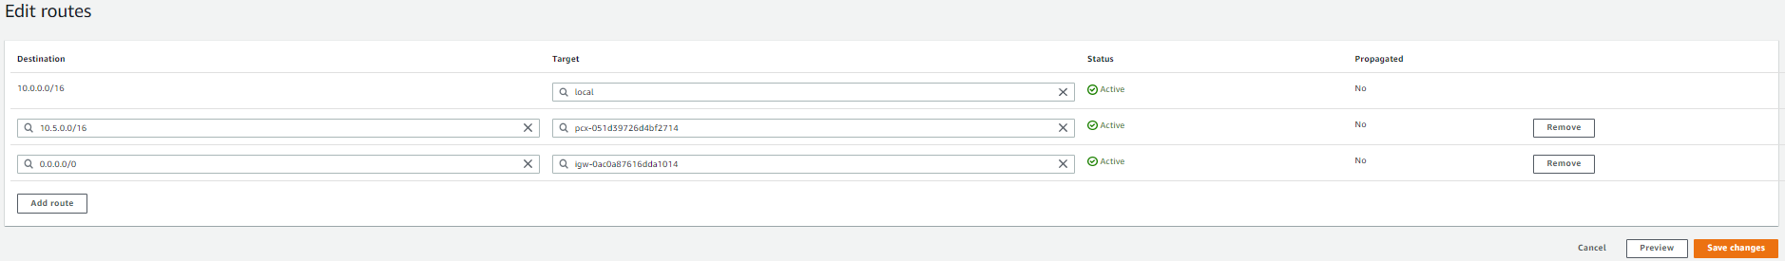
Click on add routes and then add the cidr block > choose peering connection > lab peer, then hit save changes

Slide 15
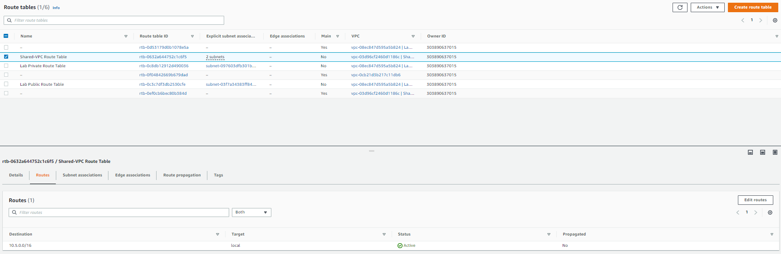
select shared-vpc route table, click on routes subtab and then edit routes

Slide 16
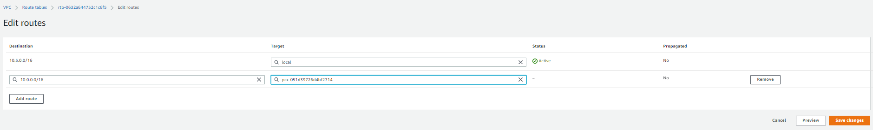
Click on add routes and then add the cidr block > choose peering connection > lab peer, then hit save changes

Slide 17
Task 3 : Testing the VPC peering connection

Slide 18
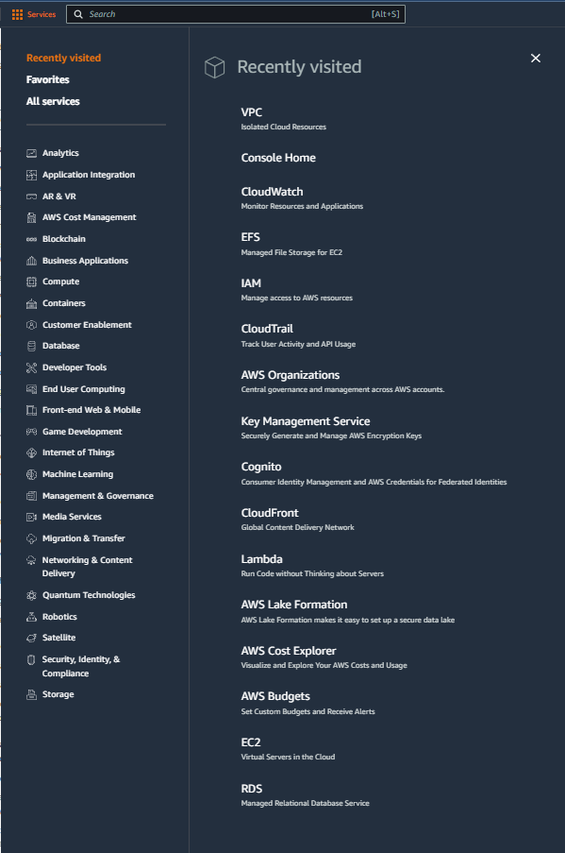
Select services and then click on EC2 button
Click on the Services button
Click on the EC2 button

Slide 19
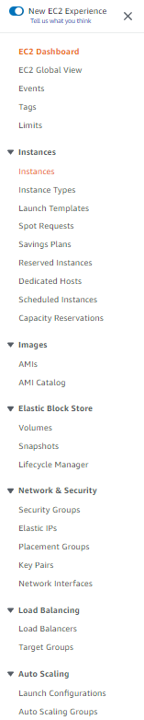
Click on instances in the navigation pane
Click on Instances

Slide 20
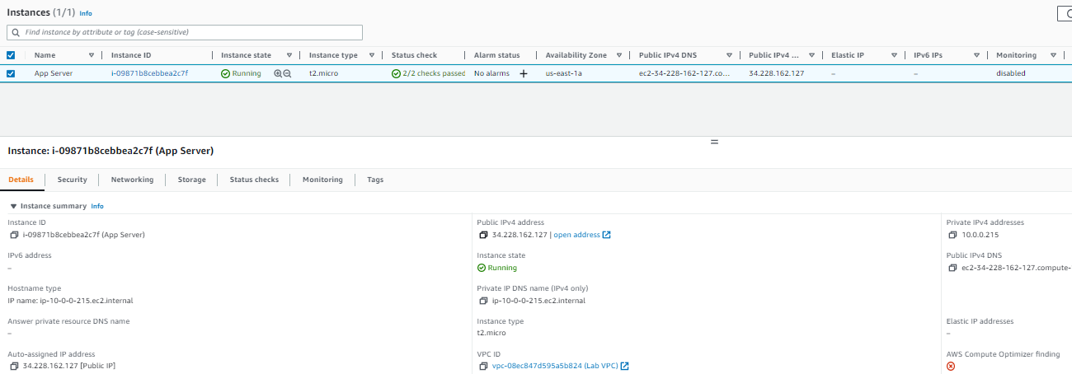
Copy the public ipv4 address

Slide 21
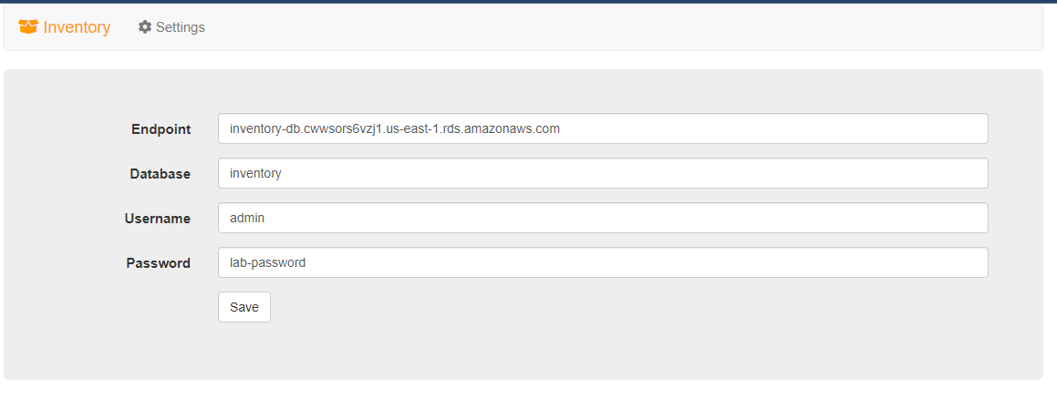
On the webpage choose settings and then configure as shown in aws labs, refer to next slide for referencing database endpoint and then click save

Slide 22
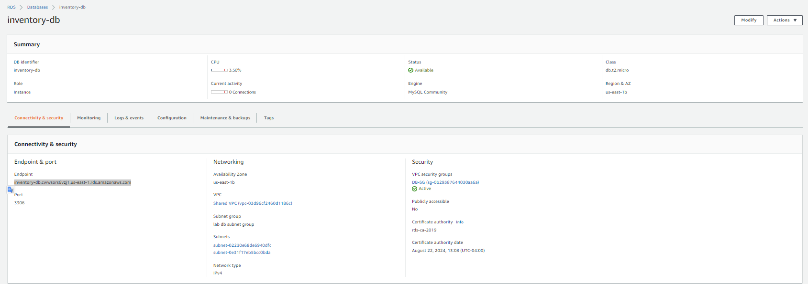
To get the database endpoint, go to rds > databases > click on inventory-db, and copy endpoint under connectivity and security

Slide 23
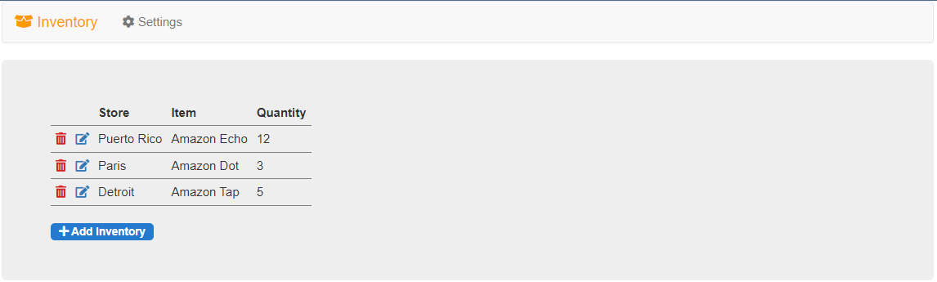
You should be able to see the data in the database

Slide 24
THANK YOU
Amrit Singh

